Slide 1


Technical IT issues around GloboDiet
International agency for research on cancer lyon - france
e-SMP

Slide 2
Outline
Installing/uninstalling GloboDiet
GloboDiet Databases
Handling of Interview Databases
Working on Interview Databases (creation & activation)
Backing up / restoring Interview databases
Exporting / importing Interview databases (xml-files)
Removing Interview Databases
Note Handling
Summary
Technical IT issues

Slide 3

Appendix 3: Installation of GloboDiet application (including both GloboDiet & SQL Server installations)
IMPORTANT – As there have been problems in the past:
Follow the guidelines
Don’t delete files or folders attached to GloboDiet (e.g.: folder C:\GloboDiet)
Ask IARC for help (Corinne Casagrande, IARC)
Practice during the demo session
Update GloboDiet application using a patch program (e.g. UPDATE-GloboDiet-20160410.exe file) rather than ‘uninstall – install’ procedure
Outline
Installing/uninstalling GloboDiet
GloboDiet Databases
Handling of Interview Databases
Working on Interview Databases
Backing up/Restoring Interview Database
Exporting/Importing Interview Databases
Removing Interview Databases
Note Handling
Summary
Technical IT issues

Slide 4
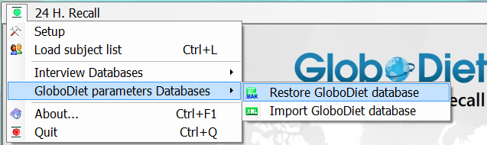
Restore GloboDiet parameter database
Called GloboDiet_xxxx.bak file
Contains all the data prepared with IARC and used during the interview (e.g. food & recipe lists, facets & quantification methods per foods…)
To be restored when you receive a new updated GloboDiet database from IARC
Remark:
For Belgium, Switzerland and Malta, this function allows to restore (or switch between) different GloboDiet databases according to the available languages
-> 1 language=1 GloboDiet database
Outline
Installing/uninstalling GloboDiet
GloboDiet Databases
Handling of Interview Databases
Working on Interview Databases
Backing up/Restoring Interview Database
Exporting/Importing Interview Databases
Removing Interview Databases
Note Handling
Summary
GloboDiet training:
Technical IT issues

Slide 5

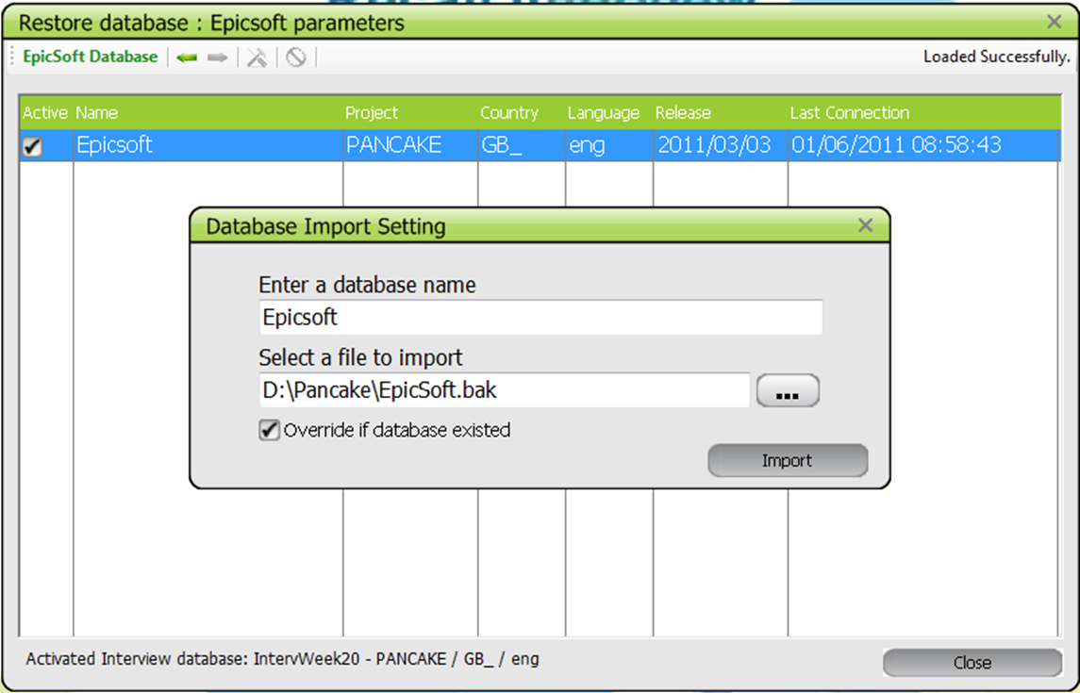
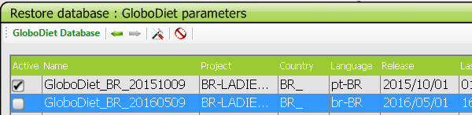
Restoring GloboDiet Databases
Give a database name to Restore GloboDiet database
Select the folder & filename to import (GloboDiet_xxx.bak file)
For an update , possibility to override an existing GloboDiet database by giving the same database name & selected the override check box
Using the tool icon you can activate the last up-to-date GloboDiet database
GloboDiet
GloboDiet
D:Pancake/GloboDiet.bak
Technical IT issues

Slide 6
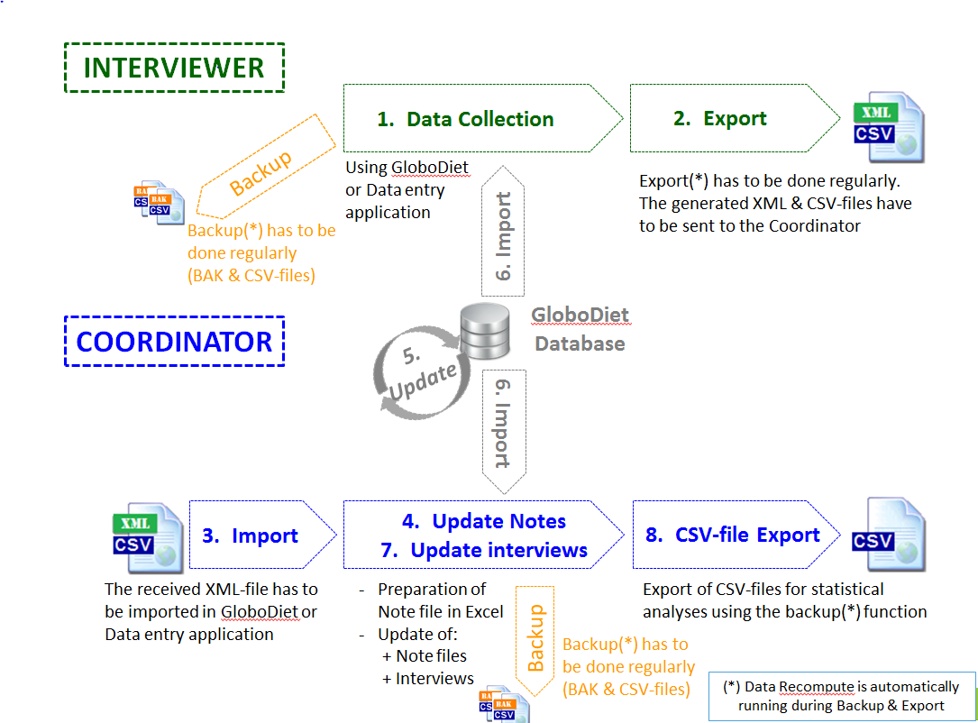
Handling of Interview Databases
Dataflow
BAK-files: internal to the computer
XML-files: to exchange with the Interviewers and Coordinators
CSV-files: for descriptive analyses generated during each data flow
Outline
Installing/uninstalling GloboDiet
GloboDiet Databases
Handling of Interview Databases
Working on Interview Databases
Backing up/Restoring Interview Database
Exporting/Importing Interview Databases
Removing Interview Databases
Note Handling
Summary
Technical IT issues

Slide 7
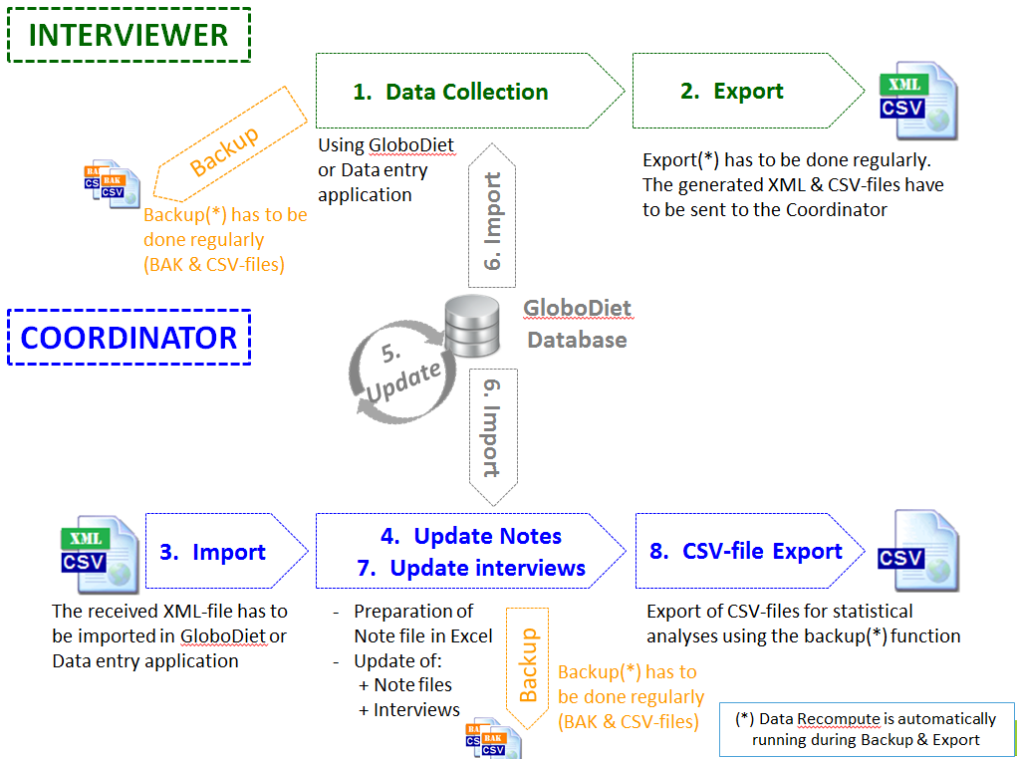
Technical IT issues

Slide 8
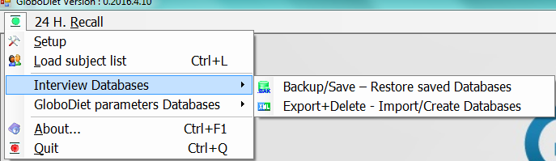

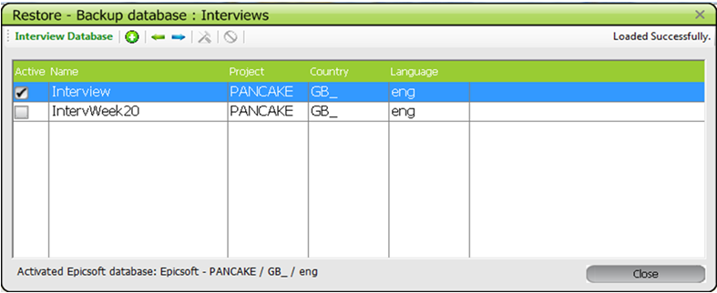
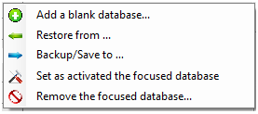
Database management: see Appendix 4
Outline
Installing/uninstalling GloboDiet
GloboDiet Databases
Handling of Interview and GloboDiet Databases
Working on Interview Databases
Backing up/Restoring Interview Database
Exporting/Importing Interview Databases
Removing Interview Databases
Note Handling
Summary
Technical IT issues

Slide 9
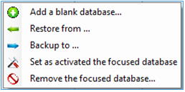
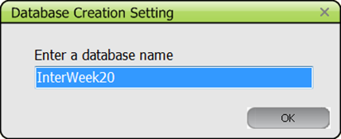
Function Add an Empty interview database
An Interview database is available by default
To start with a new set of interviews (e.g. by defined period (day, week, etc.), by interviewer etc…)
Outline
Installing/uninstalling GloboDiet
GloboDiet Databases
Handling of Interview and GloboDiet Databases
Working on Interview Databases
Backing up/Restoring Interview Database
Exporting/Importing Interview Databases
Removing Interview Databases
Note Handling
Summary
Give an interview database name
Technical IT issues

Slide 10
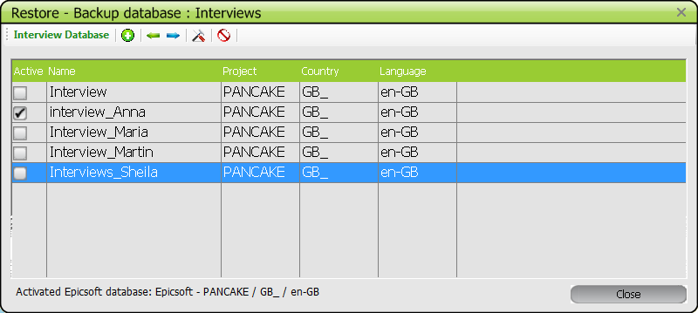
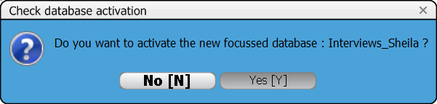
Function Activation of an interview database
If several interview databases available
To store all the new interviews to be done
Focus the cursor on the database & activate it
Outline
Installing/uninstalling GloboDiet
GloboDiet Databases
Handling of Interview and GloboDiet Databases
Working on Interview Databases
Backing up/Restoring Interview Database
Exporting/Importing Interview Databases
Removing Interview Databases
Note Handling
Summary
Technical IT issues

Slide 11
Function Backup to… generates:
a bak-file to be stored on at least 2 different supports (e.g. in a PC directory & external support such as a hard disk, USB-key & sent to a central server…)
5 csv-files, containing all the interviews available in the selected interview database for information.
During a backup, a data Recompute is running
Recommendation for Interviewers & Coordinators
Backup the interview databases very regularly (e.g. half a day, every day…)
Outline
Installing/uninstalling GloboDiet
GloboDiet Database
Handling of Interview and GloboDiet Databases
Working on Interview Databases
Backing up/Restoring Interview Database
Exporting/Importing Interview Database
Removing Interview Databases
Note Handling
Summary
Technical IT issues

Slide 12
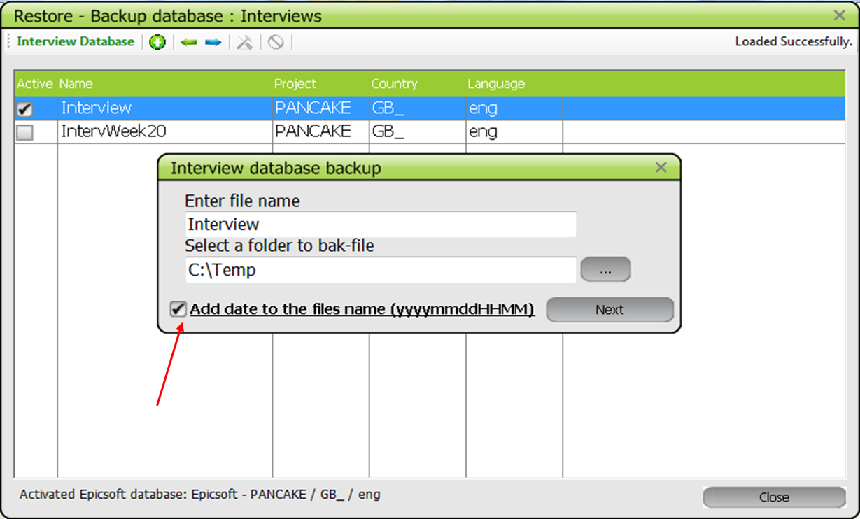
Backing up Interview Database
Date can be automatically added to the generated file name
Technical IT issues

Slide 13
Function Restore from…
Restores a previously saved interview database from a bak-file.
The main context to restore an interview database (bak-file) is in case of a PC crash
Outline
Installing/uninstalling GloboDiet
GloboDiet Databases
Handling of Interview and GloboDiet Databases
Working on Interview Databases
Backing up/Restoring Interview Database
Exporting/Importing Interview Databases
Removing Interview Databases
Note Handling
Summary
Technical IT issues

Slide 14
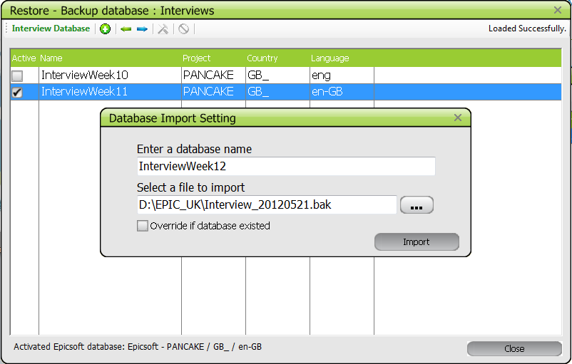
Restoring Interview Database
InterviewWeek12
D:\GLOBO_UK\Interview_20120521.bak
Technical IT issues

Slide 15
Function Export to… generates
a xml-file as communication files between the interviewers and coordinator(s)
5 csv-files, containing all the interviews available in the selected interview database for data analyses.
A bak-file in case of problem in the xml-file.
During a export, a data Recompute is running
Remarks
After the export, the selected interviews are removed from GloboDiet application
After an export, a new & empty database is automatically created & activated if no other is available.
The xml-files have to be sent to the Coordinator.
Recommendation for Interviewers:
Export the interview databases regularly (e.g. week, twice a month, monthly…)
Do not export after each interviews to avoid among of xml-files to be managed
Outline
Installing/uninstalling GloboDiet
GloboDiet Databases
Handling of Interview and GloboDiet Databases
Working on Interview Databases
Backing up/Restoring Interview Database
Exporting/Importing Interview Databases
Removing Interview Databases
Note Handling
Summary
Technical IT issues

Slide 16
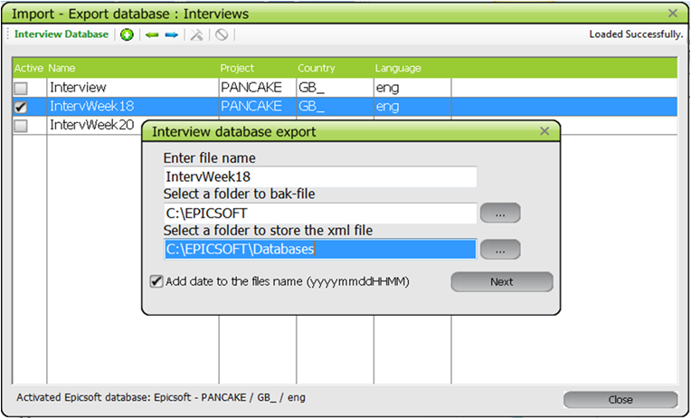
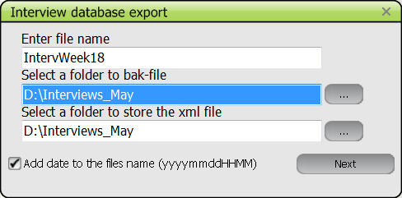
Exporting Interview Databases
Select and activate the database
1 export name
Folders
Add Date to the file name
→ The generated XML file has to be sent to the Coordinator & Import on its PC
Technical IT issues

Slide 17
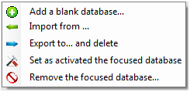
Function Import to…
xml-files management
Used as Communication files
between Interviewers & Coordinator
Used for the data cleaning
To be stored and centralized by the coordinator
Recommendation for Coordinators:
To Import in the coordinator PC at the xml-file reception
To merge the received NOTES.csv files in one file (e.g. using Excel)
Note handling:
Use of the unique NOTE Excel file using the Excel function called “Data” & “From Text”
Coordinator can comment all the received notes by:
Adding information in the comment column
Changing the Note Status (e.g. from New to Nothing to do)
Edit the interview and update it using GloboDiet applicaton
Outline
Installing/uninstalling GloboDiet
GloboDiet Databases
Handling of Interview and GloboDiet Databases
Working on Interview Databases
Backing up/Restoring Interview Database
Exporting/Importing Interview Databases
Removing Interview Databases
Note Handling
Summary
Technical IT issues

Slide 18
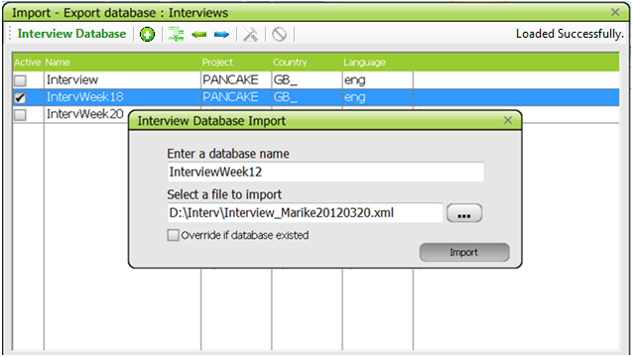
Importing Interview Databases (1/2)
Give a database name to import the interviews.
Select the folder & filename (xml-file) to import
Possibility to override an existing database
→ not recommended
Technical IT issues

Slide 19
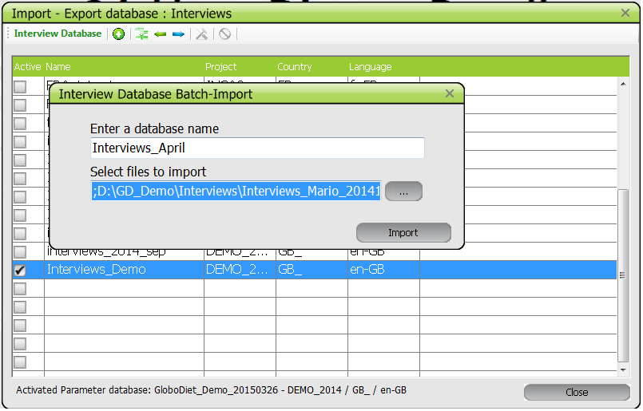
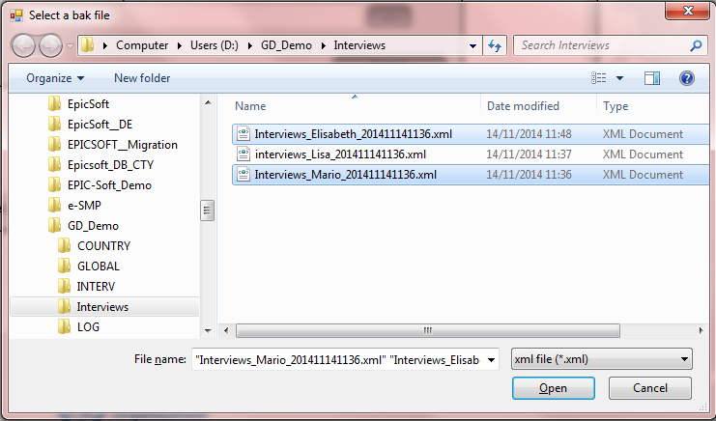
Import of Interview Databases (2/2)
BATCH-Import
Give an interview database name to import the interviews
OR give an existing database name to cumulate interviews.
Select the folder & several filenames (xml-files) to import

Slide 20
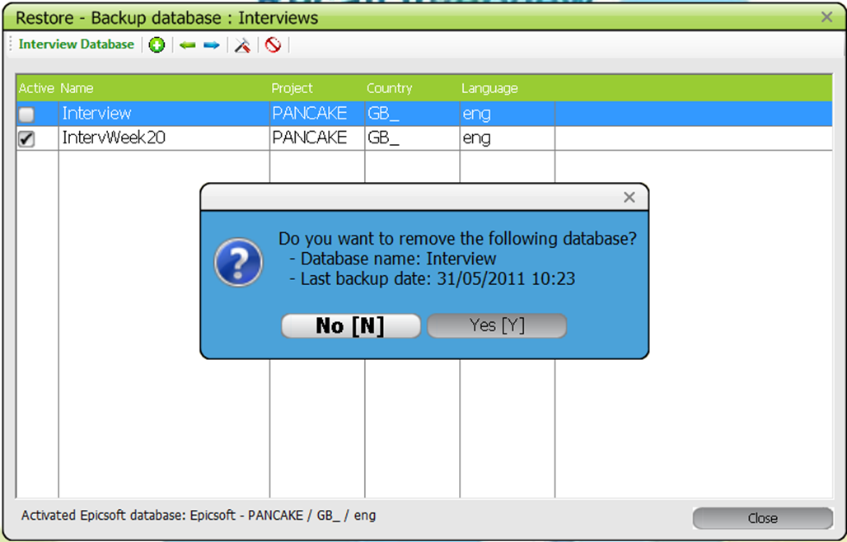
Remove an Interview database function
Available but strongly recommend not to use it
First focus a database then Remove it
Only non-activated database can be removed
Outline
Installing/uninstalling GloboDiet
GloboDiet Databases
Handling of Interview and GloboDiet Databases
Working on Interview Databases
Backing up/Restoring Interview Database
Exporting/Importing Interview Databases
Removing Interview Databases
Note Handling
Summary
Technical IT issues

Slide 21
Note handling to prepare the data cleaning
Use of the unique NOTE Excel file using the Excel function called “Data” & “From Text”
Coordinator can comment all the received notes by:
Adding information in a added comment column
Changing the Note Status (e.g. from New to Nothing to do)
Using GloboDiet application:
Import interview databases
Activate an Interview database
Edit & Update the attached interviews
Backup the updated interview database to generate the csv-files & bak-file
Data Analyses
Use and merge the generated csv-files (e.g. using SAS…)
Quality control analyses
Guidelines:
Data cleaning protocol_xxxx.docx
Appendix 4_BackupRestore_document_xxxx.doc
Appendix 6_Export_guideline_xxxx.doc
Appendix 7_read_of_export_with_SAS_programs.doc
Outline
Installing/uninstalling GloboDiet
GloboDiet Databases
Handling of Interview and GloboDiet Databases
Working on Interview Databases
Backing up/Restoring Interview Database
Exporting /Importing Interview Databases
Removing Interview Databases
Note Handling
Summary
Technical IT issues

Slide 22
Main used functions in GloboDiet for the data management are:
Save very regularly interviews using the Backup to function
In case of PC failure, the Restore interviews function has to be used (bak-file)
Export & delete Interviews regularly using the export function in order to send them to Coordinator.
Reception & Import interviews coming from Interviewers to centralized them
Handling the Notes using the Note files (outside GloboDiet)
Restore a new updated GloboDiet database (if available)
Edit and Update the interviews
Generate the csv-files using the backup function for data analyses
Outline
Installing/uninstalling GloboDiet
GloboDiet Databases
Handling of Interview and GloboDiet Databases
Working on Interview Databases
Backing up/Restoring Interview Database
Exporting/Importing Interview Databases
Removing Interview Databases
Note Handling
Summary
Technical IT issues

Slide 23
Technical IT issues around GloboDiet
International agency for research on cancer lyon - france
e-SMP

